Slide 1
1.125 – Software Engineering and Architecting
Lecture 1
Course Outline and Introduction to the World Wide Web

Slide 2















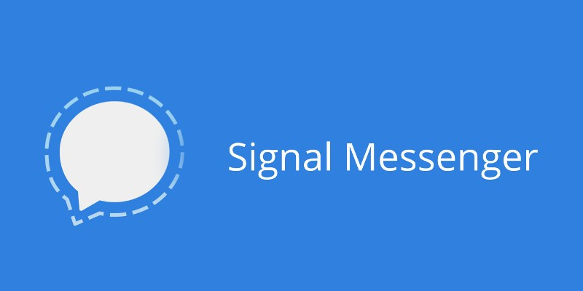

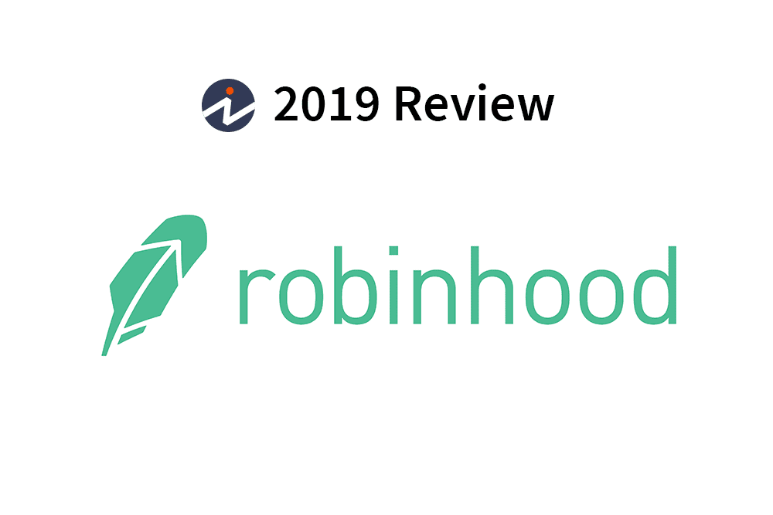

The New Web Economy
New Building Blocks
Notes:
Our world is being transformed by the relentless advances in computing development and deployment. Nowadays there is almost no industry left to be affected.
The world is getting faster.
The tools that exist nowadays enable small teams to topple giants and move at a pace not seen before.
Abstraction and modularity are king. Knowing how to wield these pieces opens up a whole new world of opportunities and innovative solutions.

Slide 3
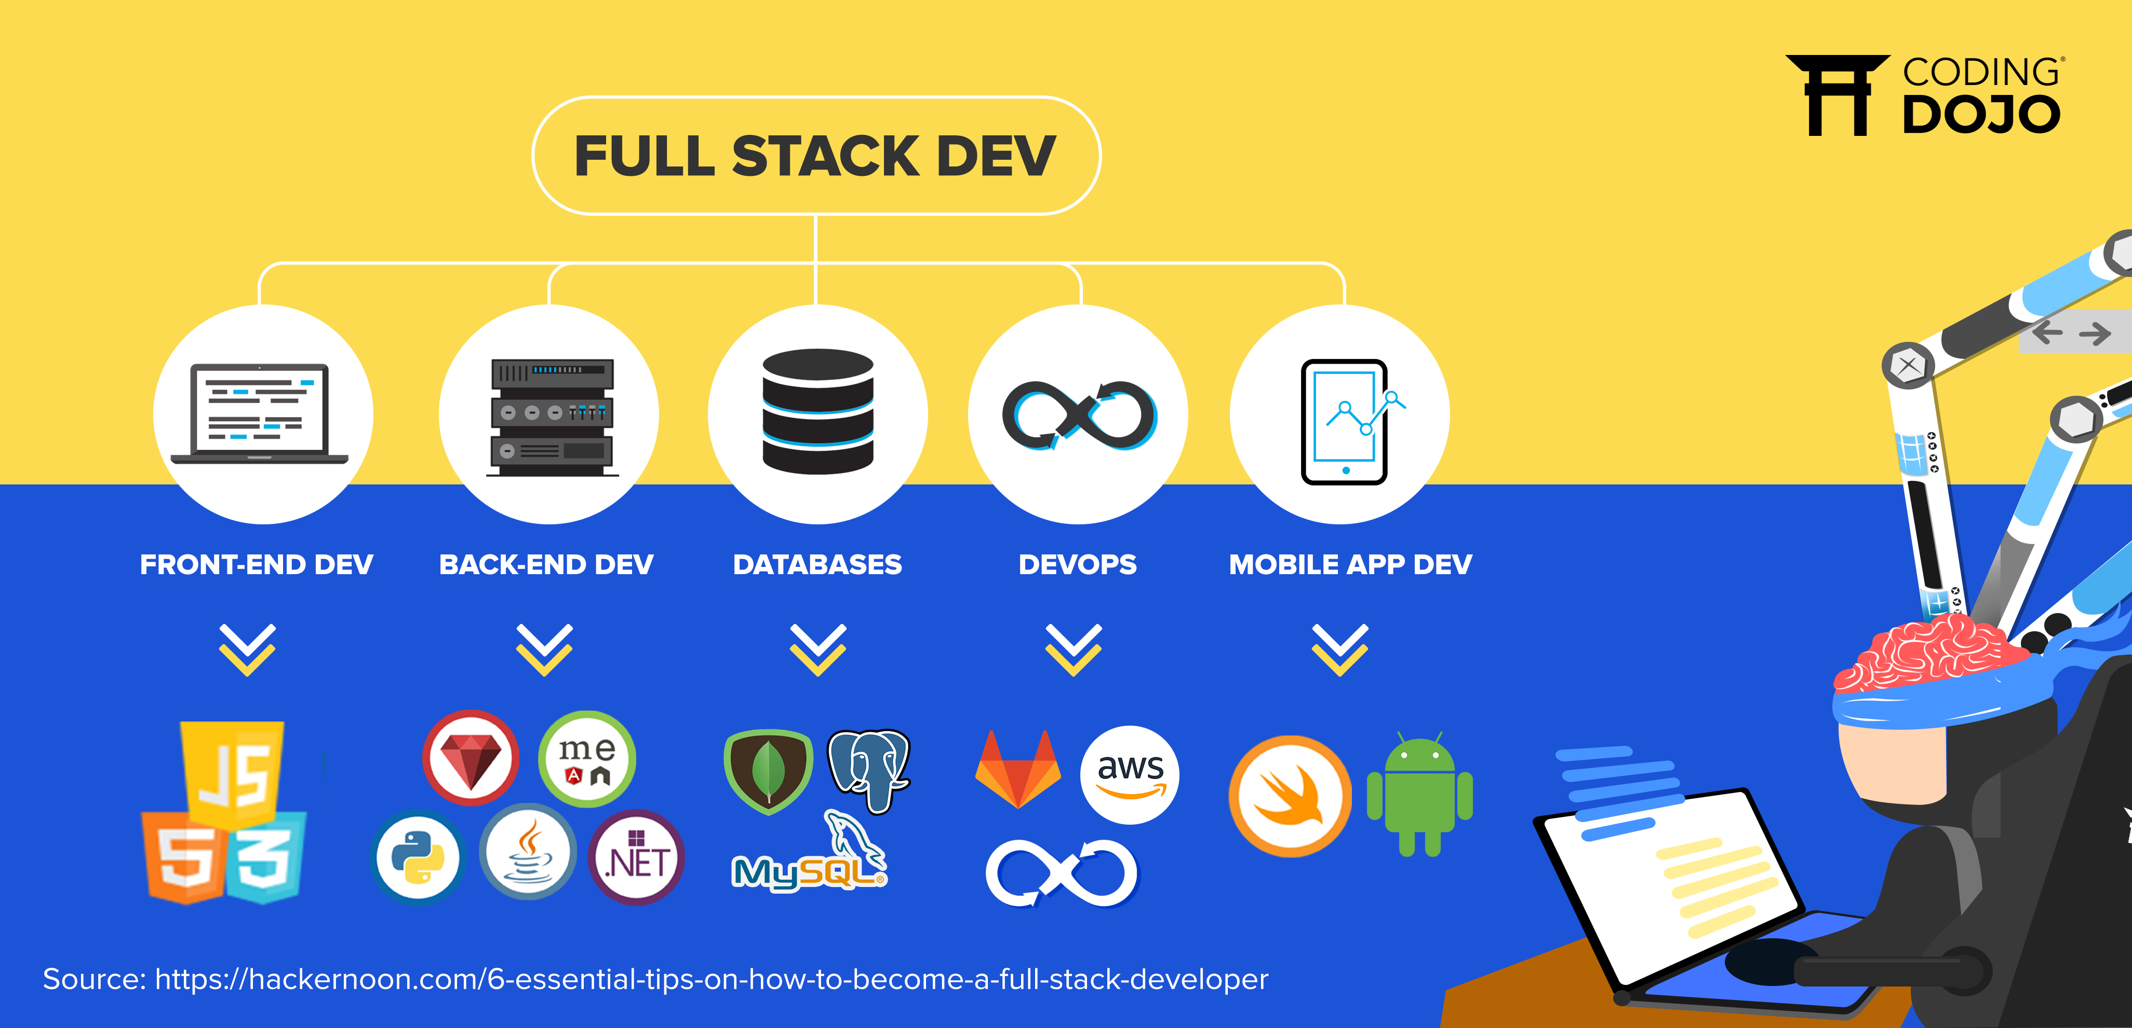
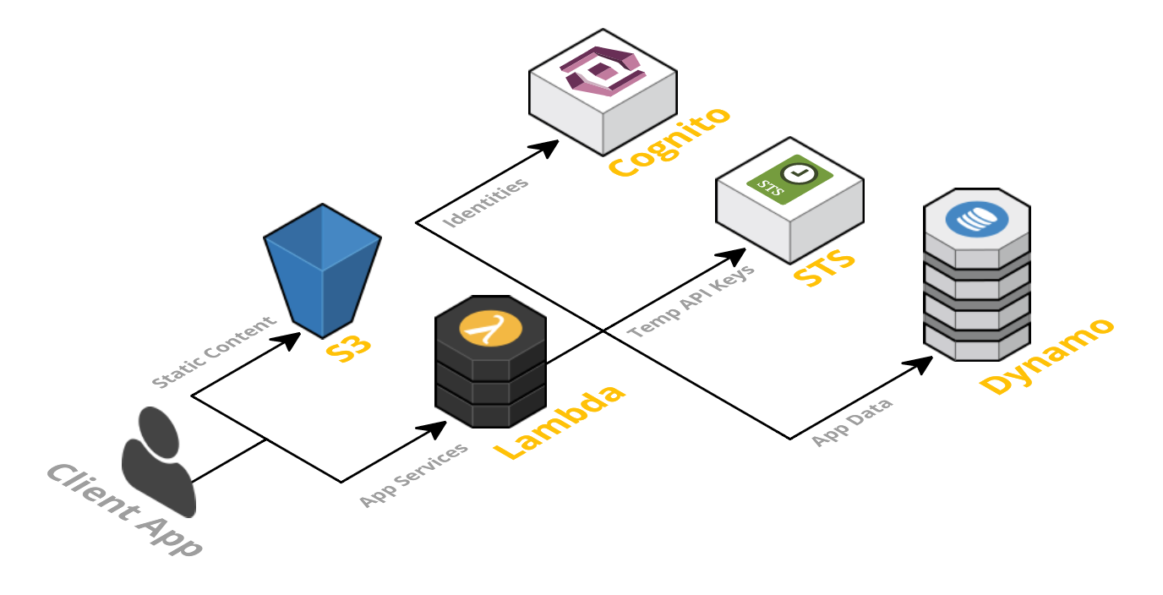

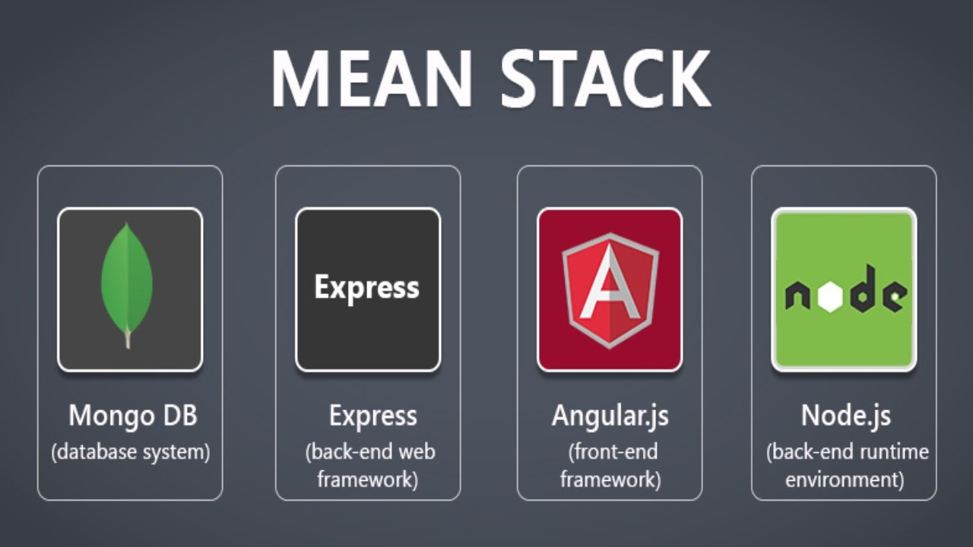
1.125- Software Engineering and Architecting
If the internet is “a series of tubes” – Modern software is a “stack of blocks”
A ‘serverless’ stack
Notes:
Today the software world is defined by the modularity and interoperability.
Knowing what these different pieces are and how they can be put together means that new innovations and products are waiting to be built.
This course is aimed at those who want to know what these pieces are, how they work and how to put them together.
"A series of tubes" is a phrase coined originally as an analogy by then-United States Senator Ted Stevens (R-Alaska) to describe the Internet

Slide 4


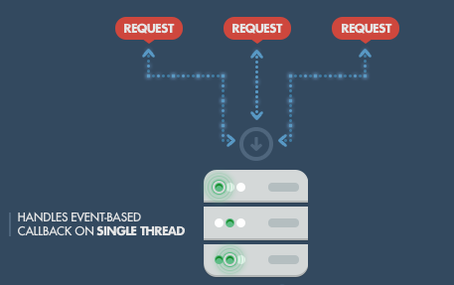
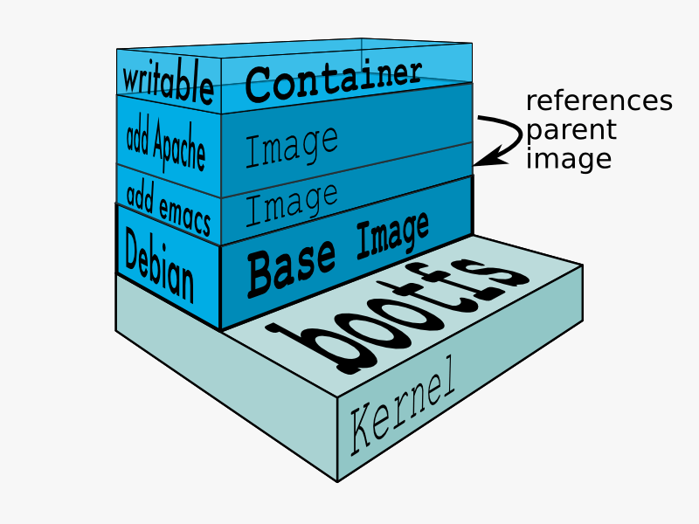
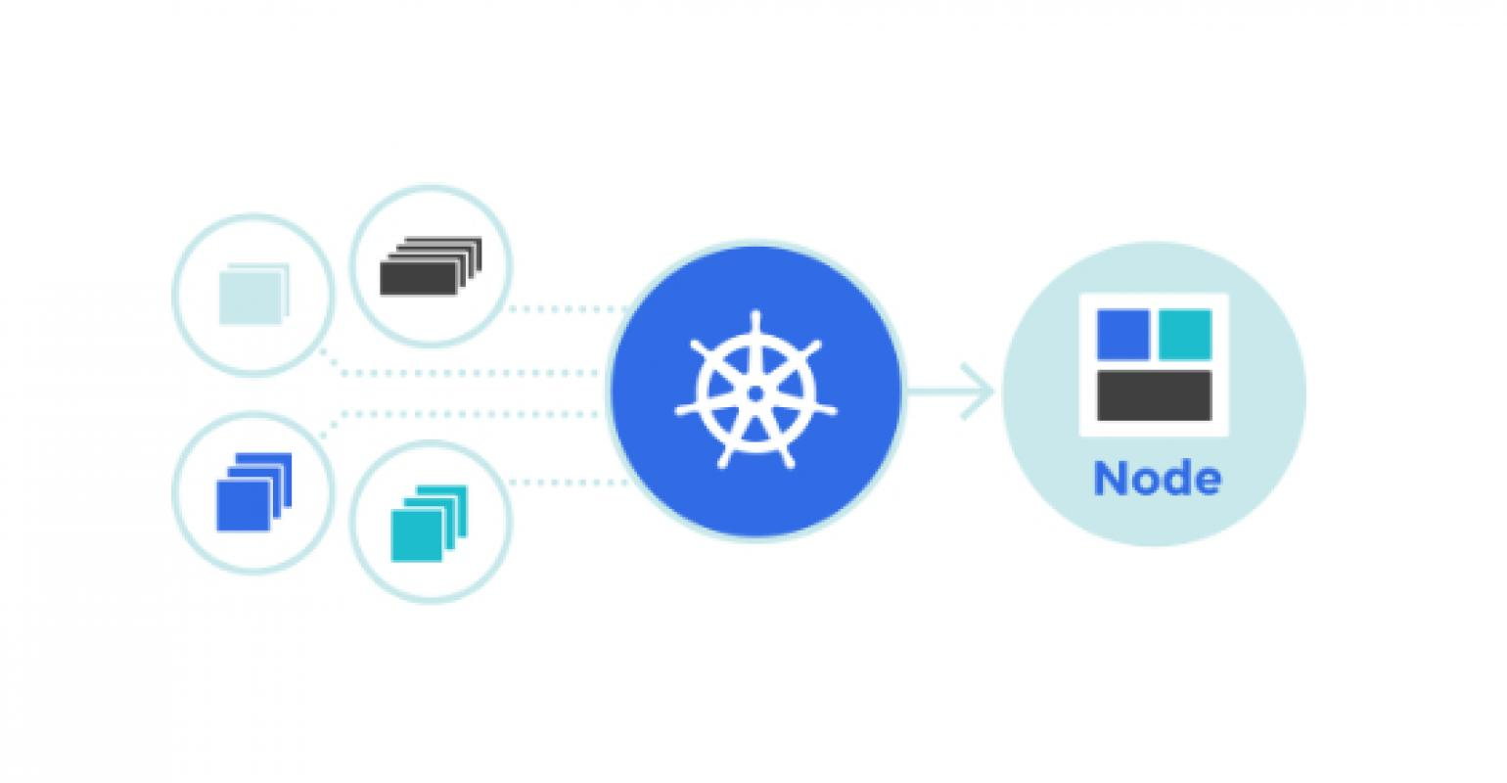
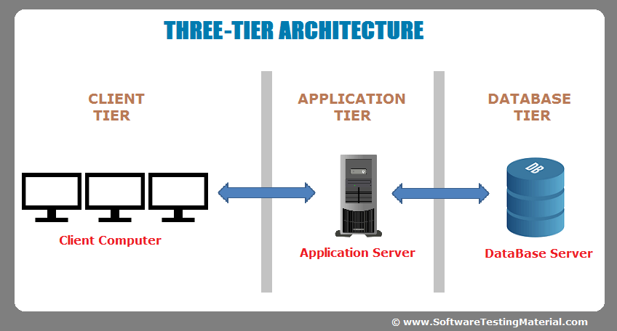
Course Outline
Topic 0 (today): Introduction, Overview, and Set Up
Topic 1: The Front End - JavaScript and Understanding the Web
Topic 2: The Back End - GitHub
Topic 3: Open Source and Collaboration – NodeJS
Topic 4: Containers and Portable Code – Docker
Topic 5: Using The Cloud - AWS/Digital Ocean
Topic 6: Connecting to Services – APIs
Topic 7: Special Topic – Blockchain
Final Project

Slide 5

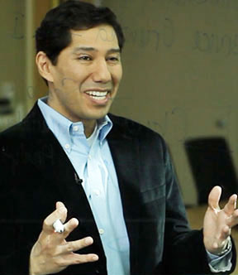


Course Staff
Prof. John Williams
jrw@mit.edu
Dr. Abel Sanchez
abel@mit.edu
Sam Raymond
sjr@mit.edu
Our Research:
Machine Learning
Cyber Security
Digital Transformation
Blockchain
Online Education
Resource Exploration
Numerical Simulation
Computational Mechanics

Slide 6
Assessment
Homework (30%)
Each class we will be doing in-class work involving coding and interacting with the technologies we’ll be studying. Each week you will be required to submit work based on these in-class activities.
Quiz (20%)
We will hold a quiz (date TBD) in class covering some of the fundamentals of what will be necessary to work with the new tools of the web.
Final Project (50%)
The final part of this course involves a group project where you will take what has been covered (and extra if required) and create a new application.
Proposal (10%)
Final Presentation (20%)
Final Deliverable (20%)
Notes:
Quiz likely to be peer-graded

Slide 7
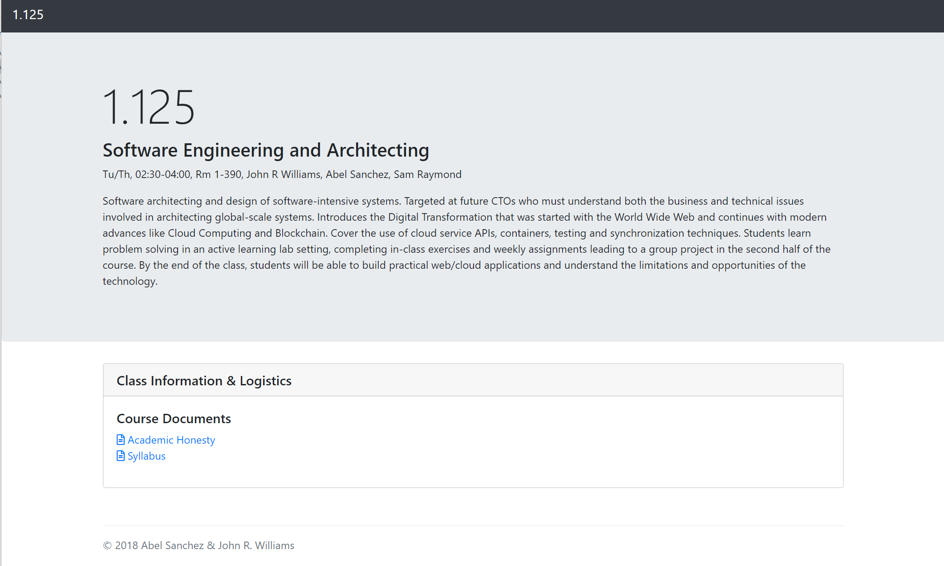
Our Class Website
https://neopoxo.org/

Slide 8
Final Projects
https://onexi.org/projects_standalone.html

Slide 9

The World Wide Web

Slide 10
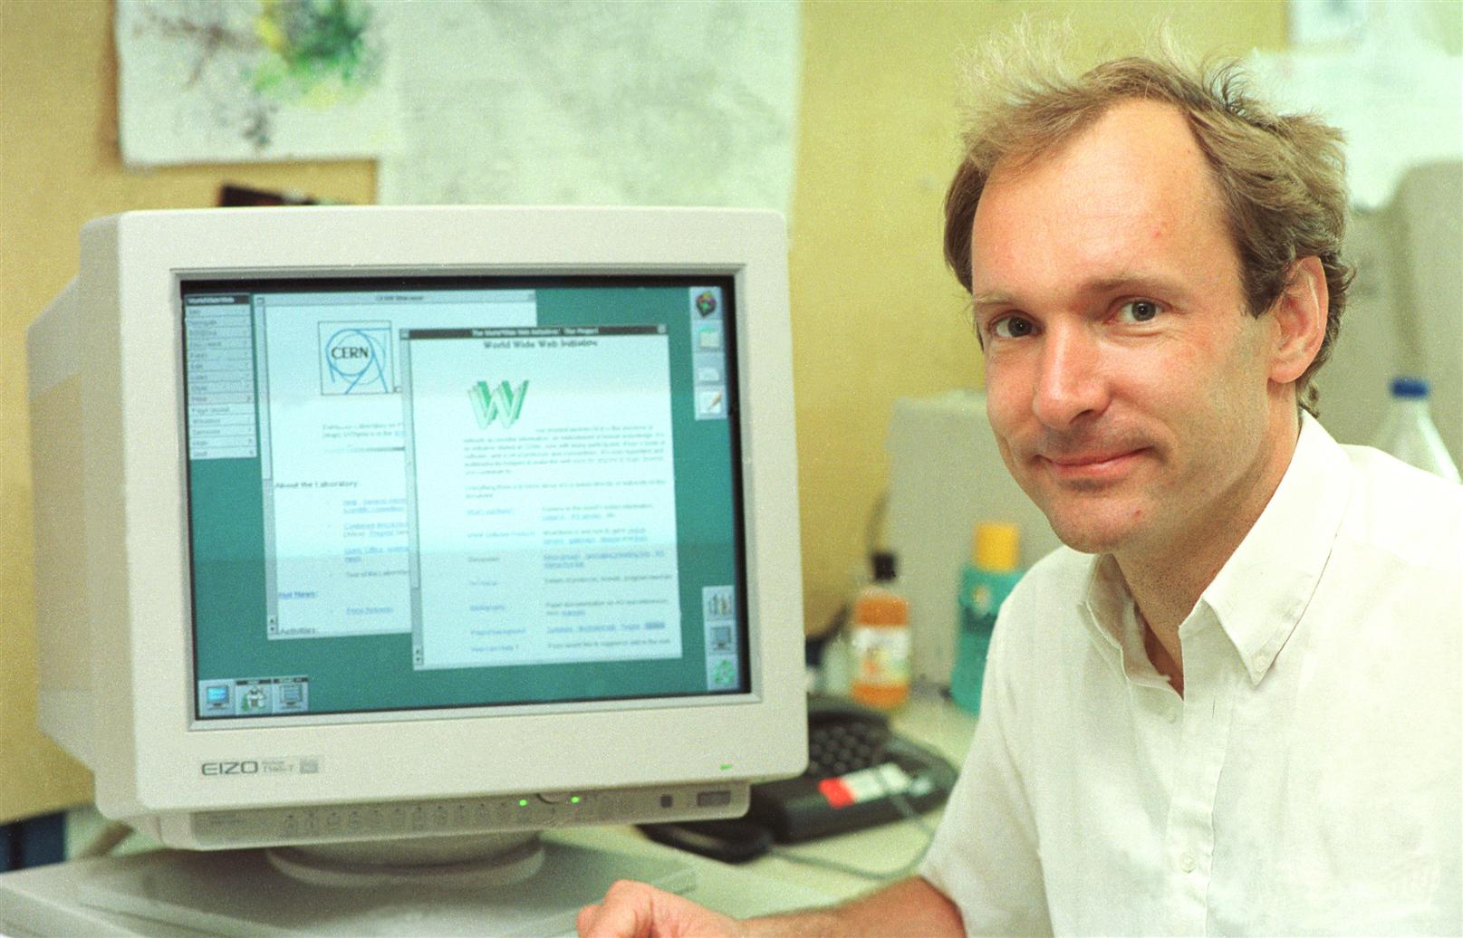
?????????????

Slide 11
Sir Tim Berners-Lee

Slide 12
Sir Tim Berners-Lee
…invented the World Wide Web in 1989

Slide 13
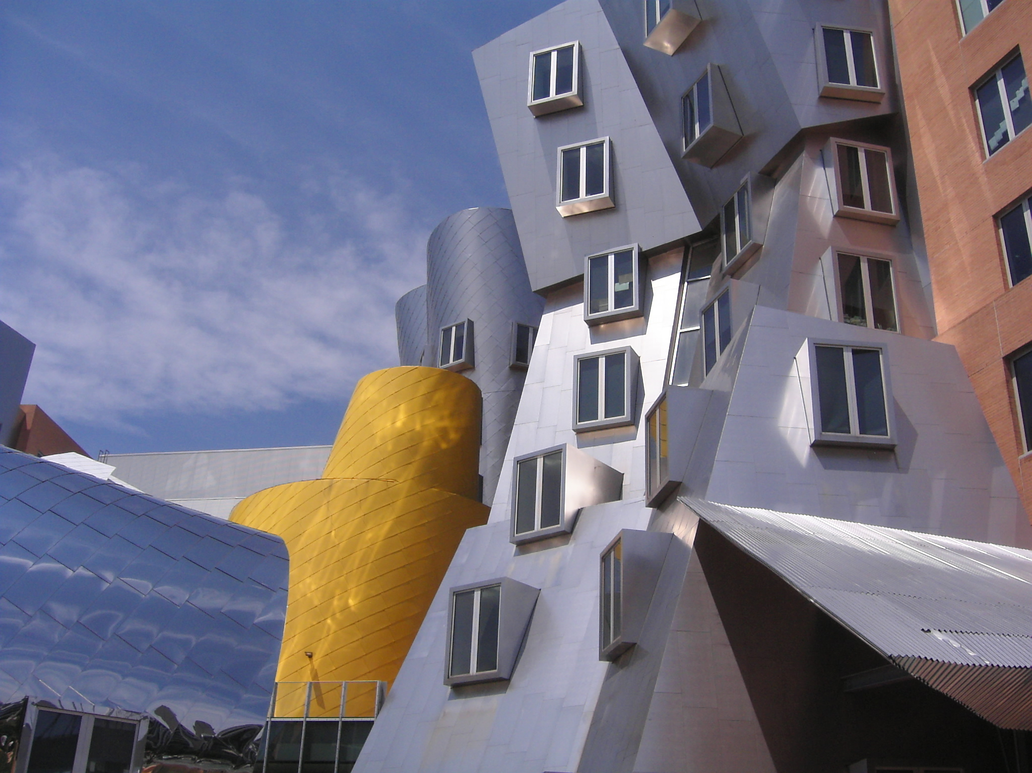
Sir Tim Berners-Lee
Works Here
…invented the World Wide Web in 1989

Slide 14
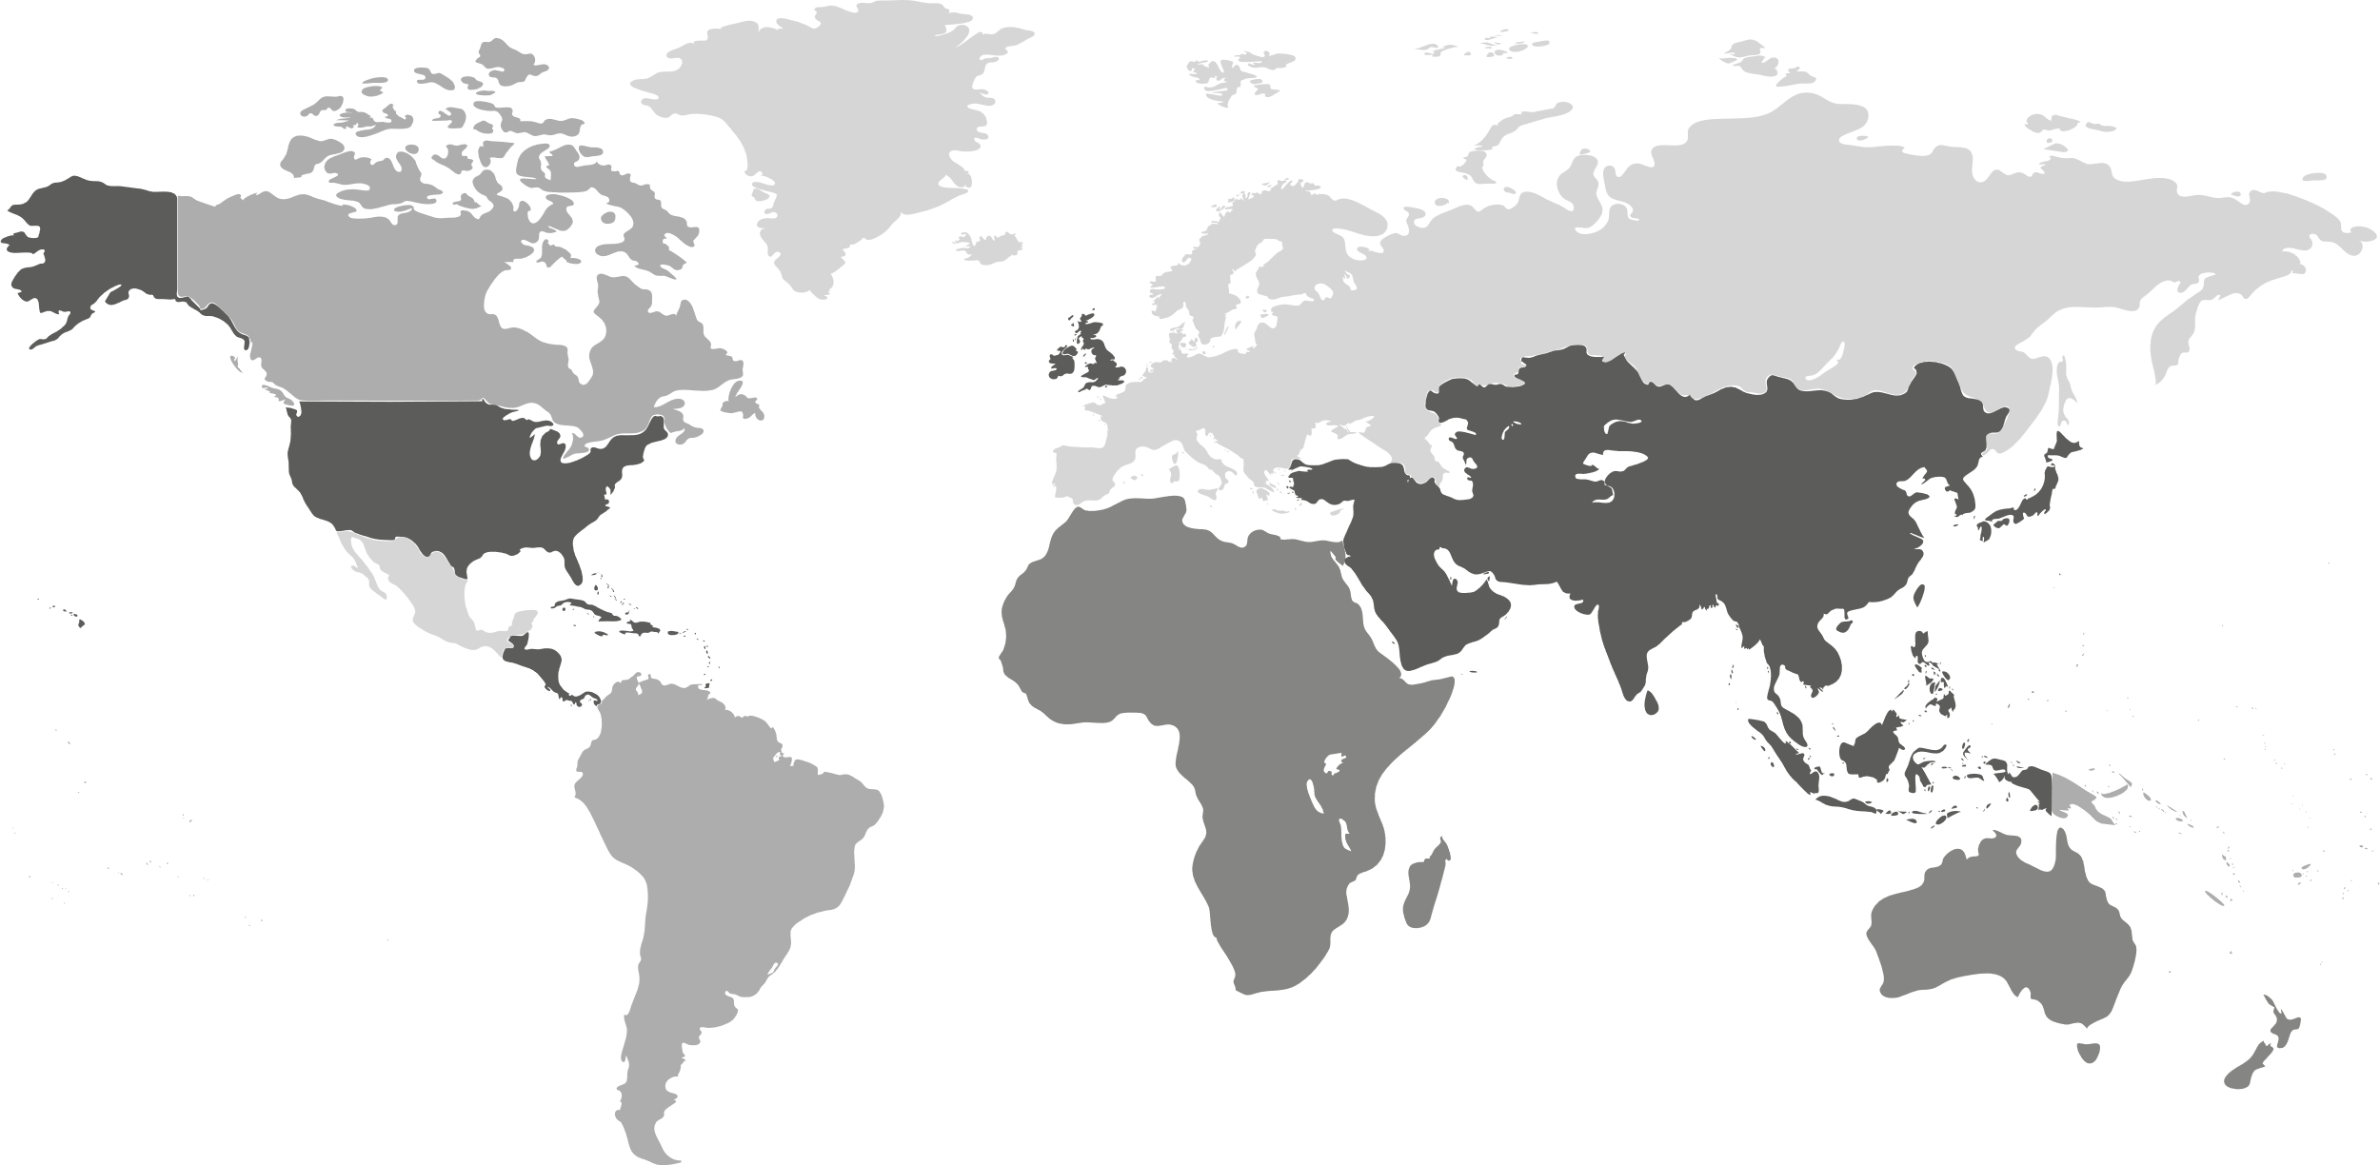

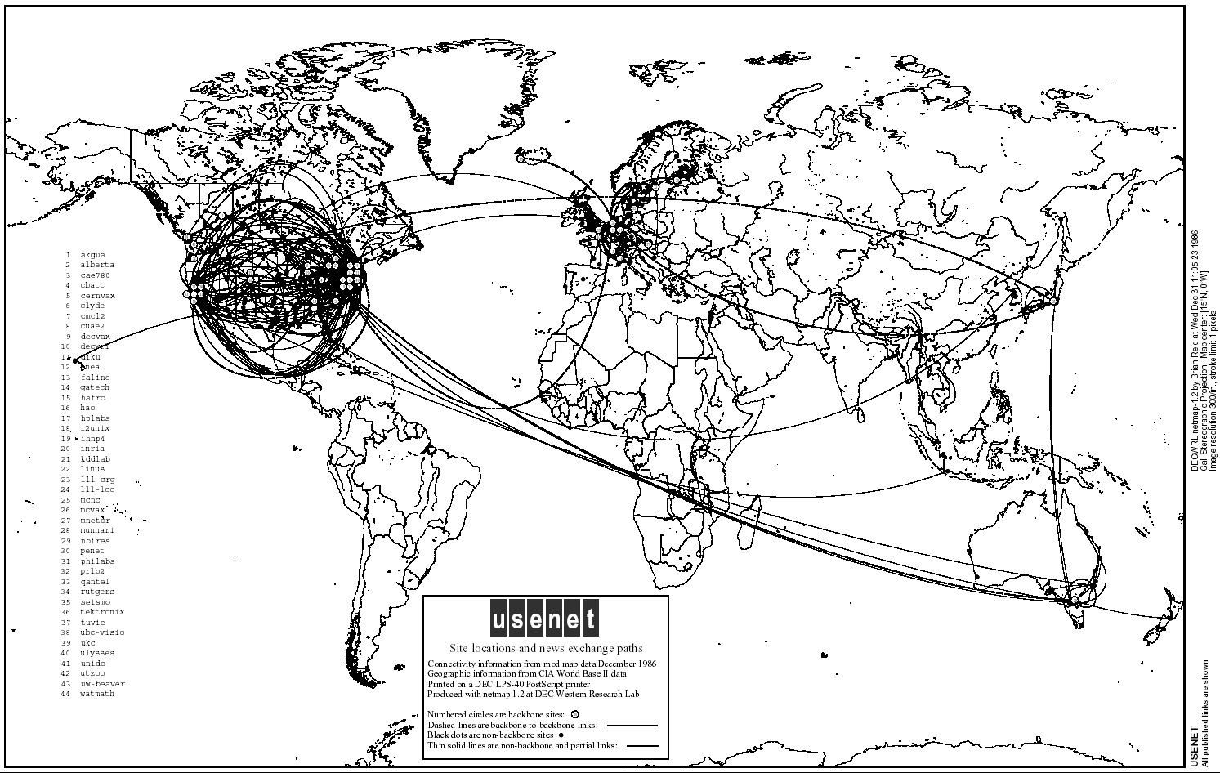
The Problem
But researchers couldn’t communicate
Internet Connections Existed
Notes:
Lots of researchers around the world started creating digital documents.
They wanted to share them
They couldn’t.

Slide 15
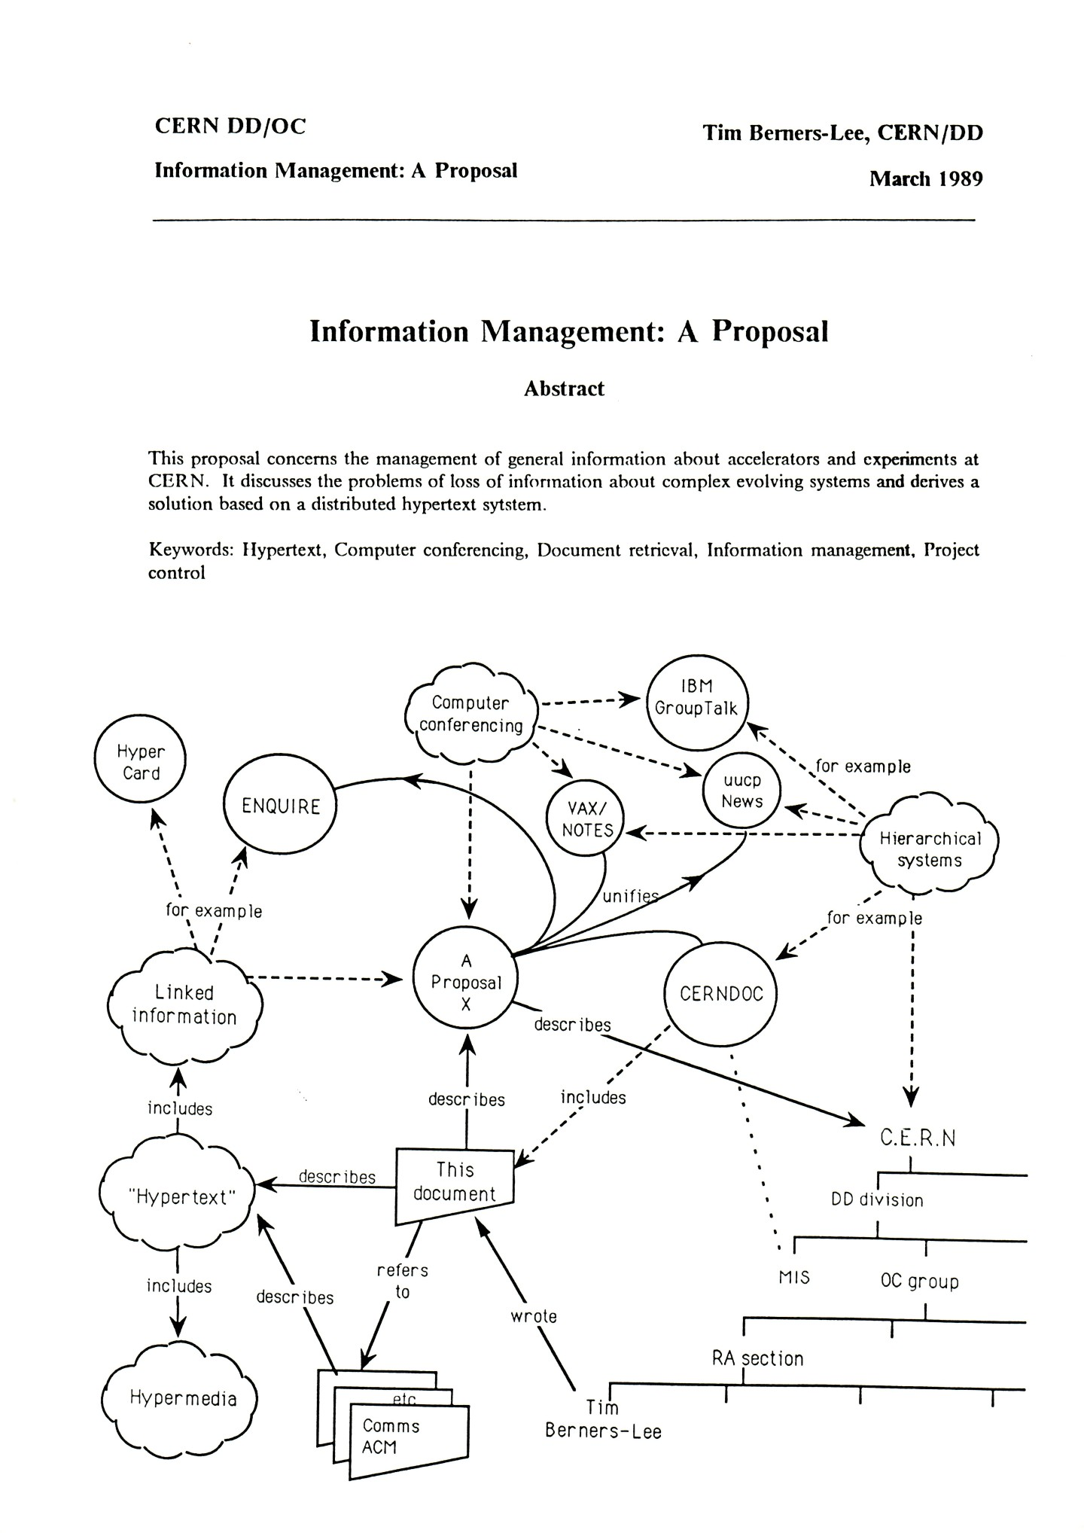
The Solution: HyperLinks

Slide 16
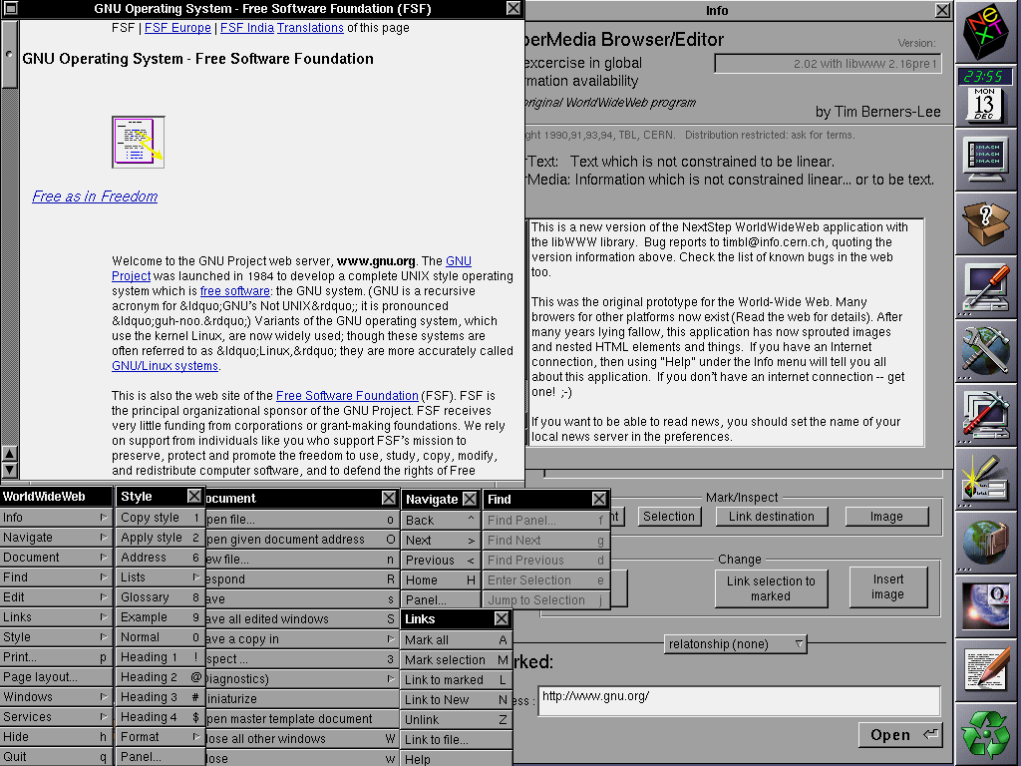
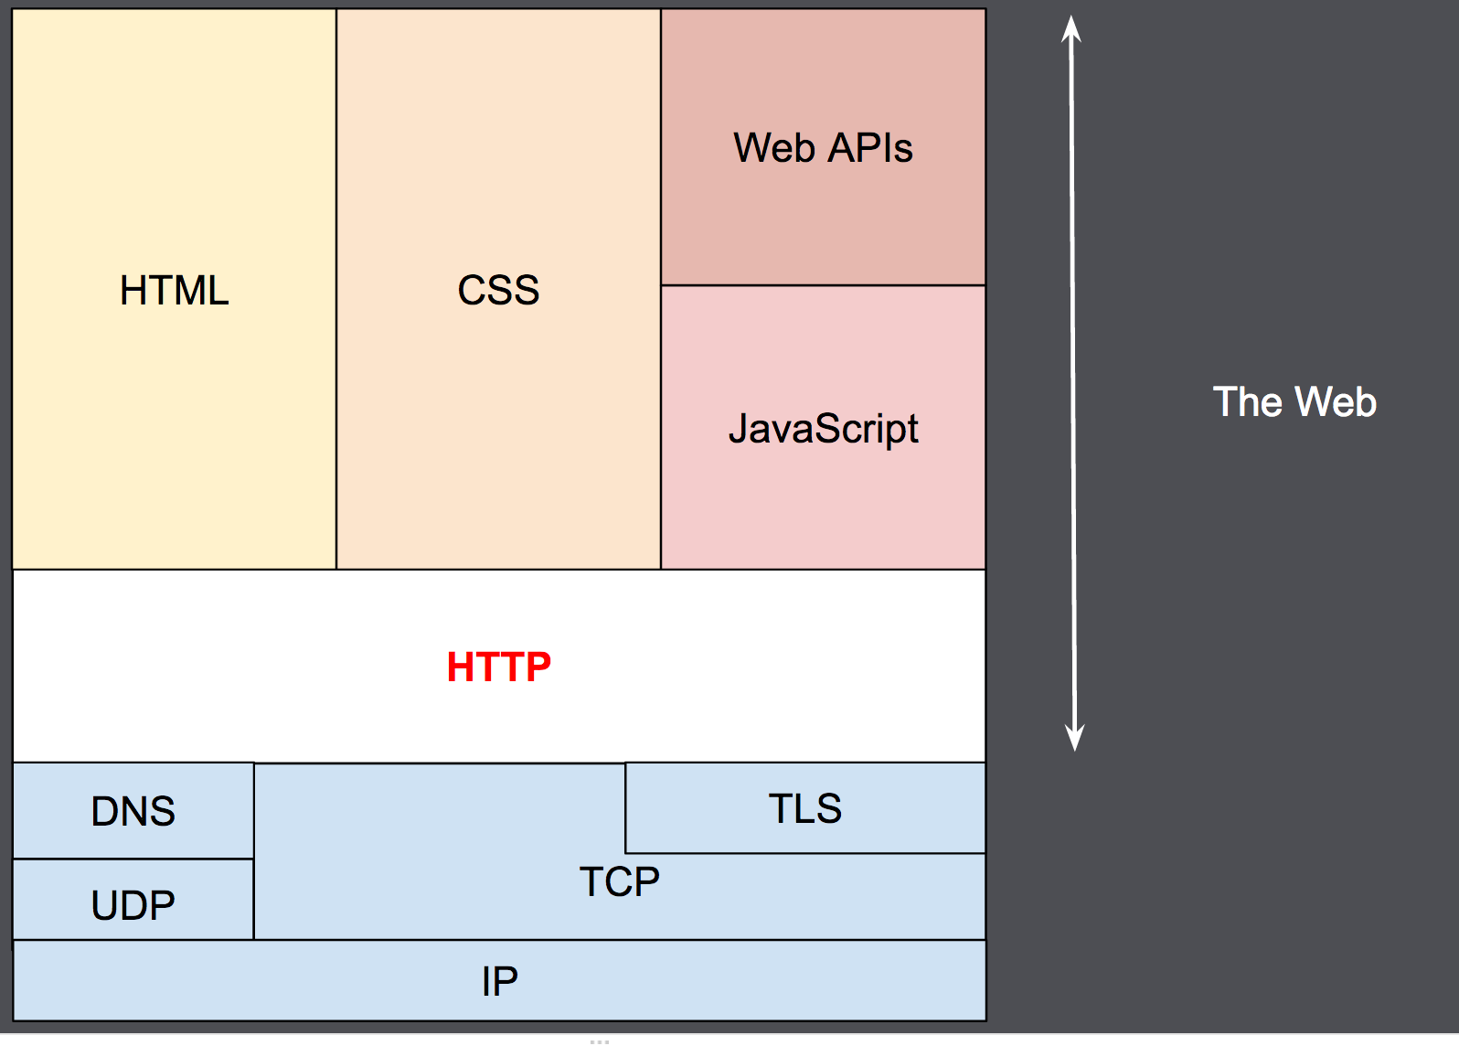

The Solution: HTTP + HTML + Browser
Hyper Text Markup Language - HTML
Hyper Text Transfer Protocol - HTTP
Web Browser

Slide 17
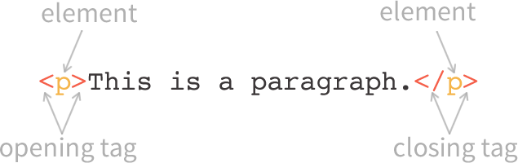
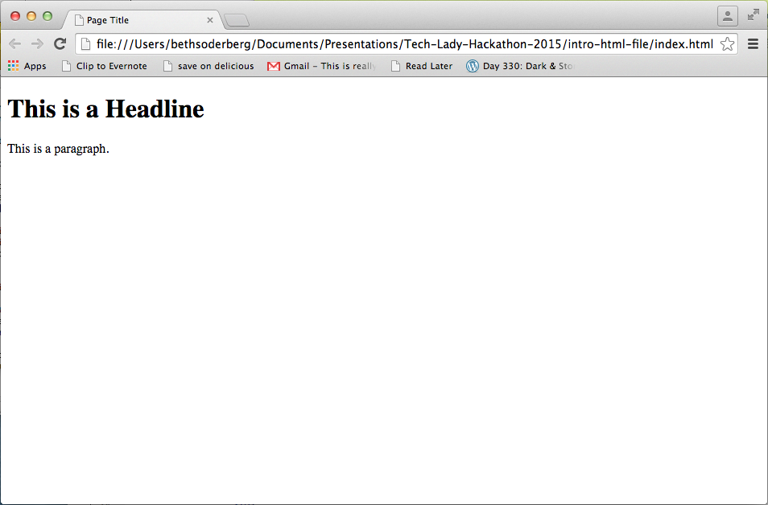
HTML – Hyper Text Markup Language
<!DOCTYPE html>
<html>
<head>
<title>Page Title</title>
</head>
<body>
<h1>Homepage Headline</h1>
<p>This is a paragraph.</p>
</body>
</html>

Slide 18
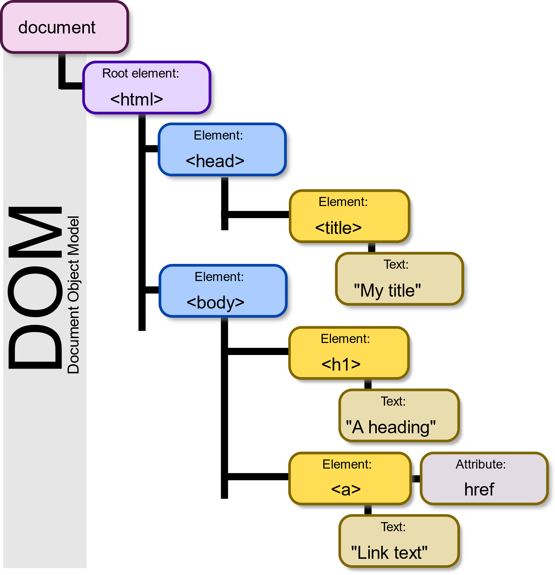
DOM – Document Object Model

Slide 19
In-Class Activity HelloWorld.html
Notes:
Create a new text file:
Helloworld.html
Use the developer console to look at the Document Object Model

Slide 20
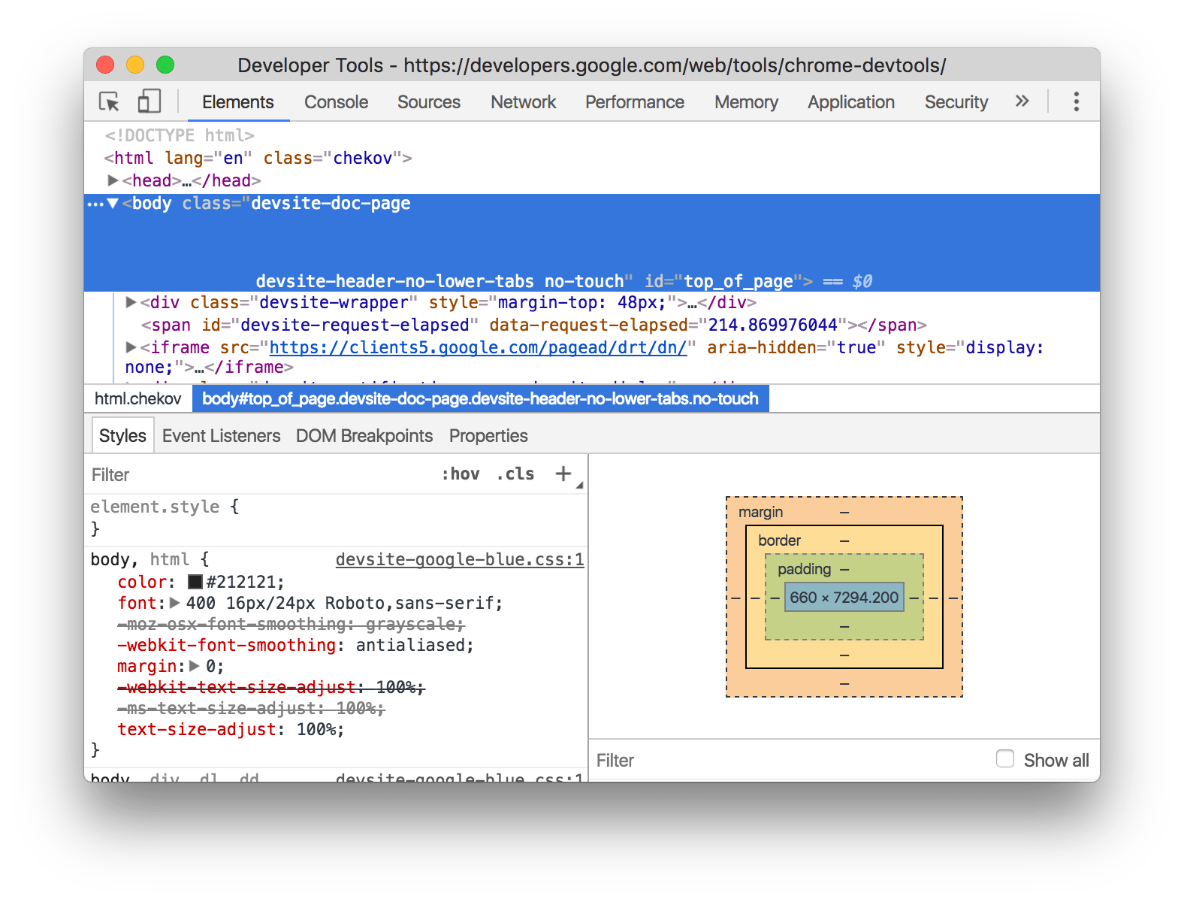
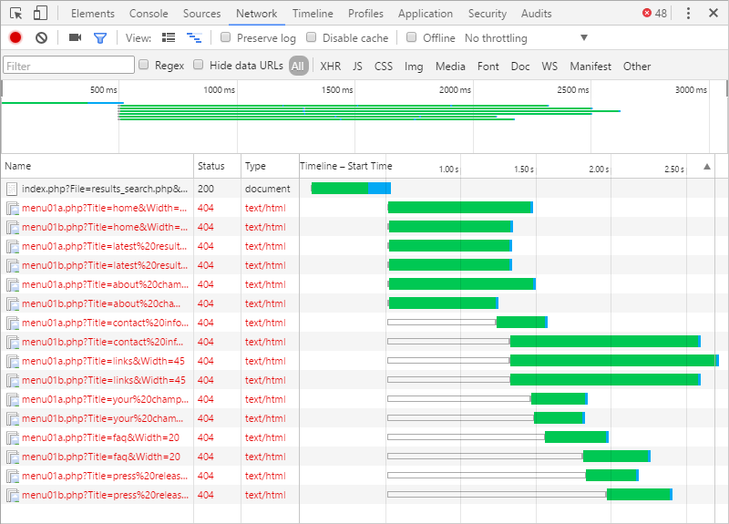
The Developer Tools

Slide 21
Homework 0: Getting Setup
So that everyone is working with the same software, this week’s homework is to install and set up the following:
VSCode – The recommended code editor
NodeJS – The JavaScript runtime environment
GitHub Account – Where we will be storing/submitting all our work
GitCLI – So we can connect to our GitHub account
Google Chrome – Our Web Browser of choice

